Slide 1
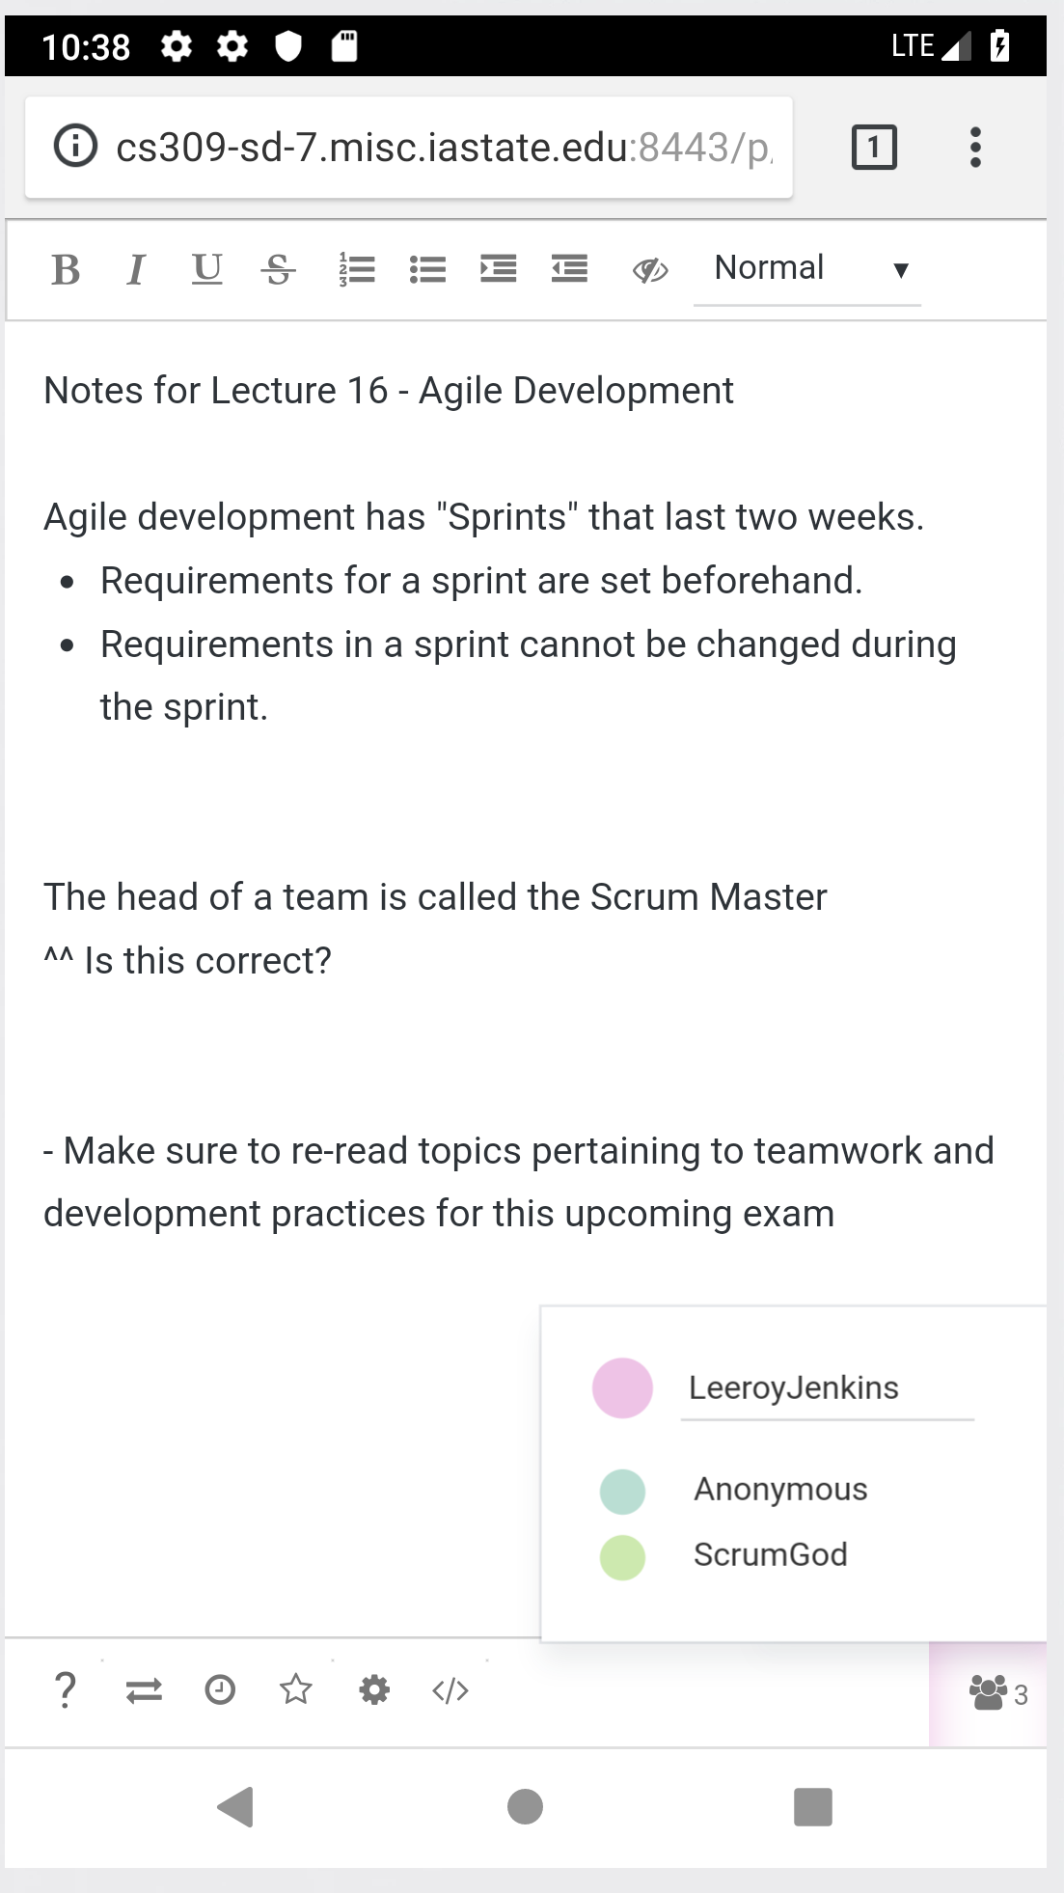
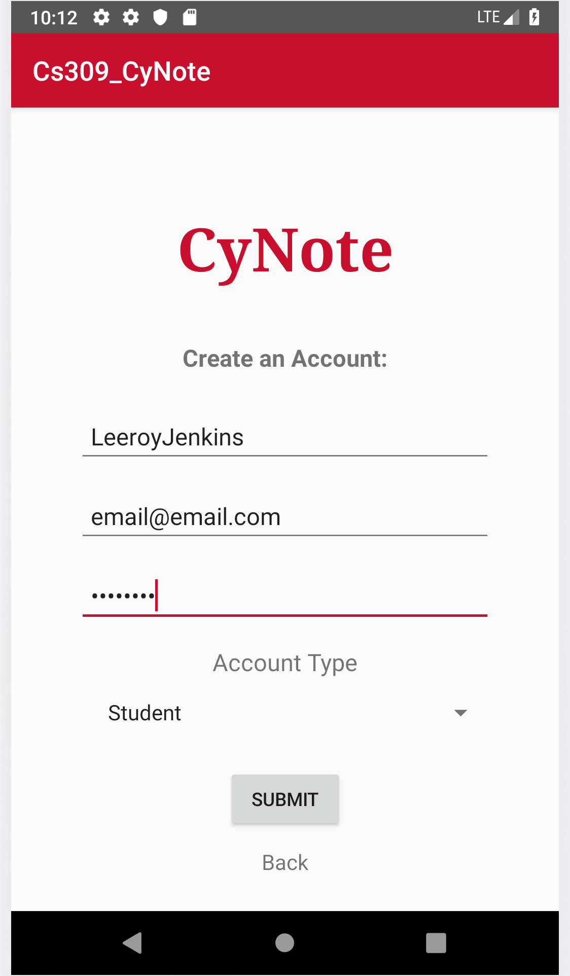
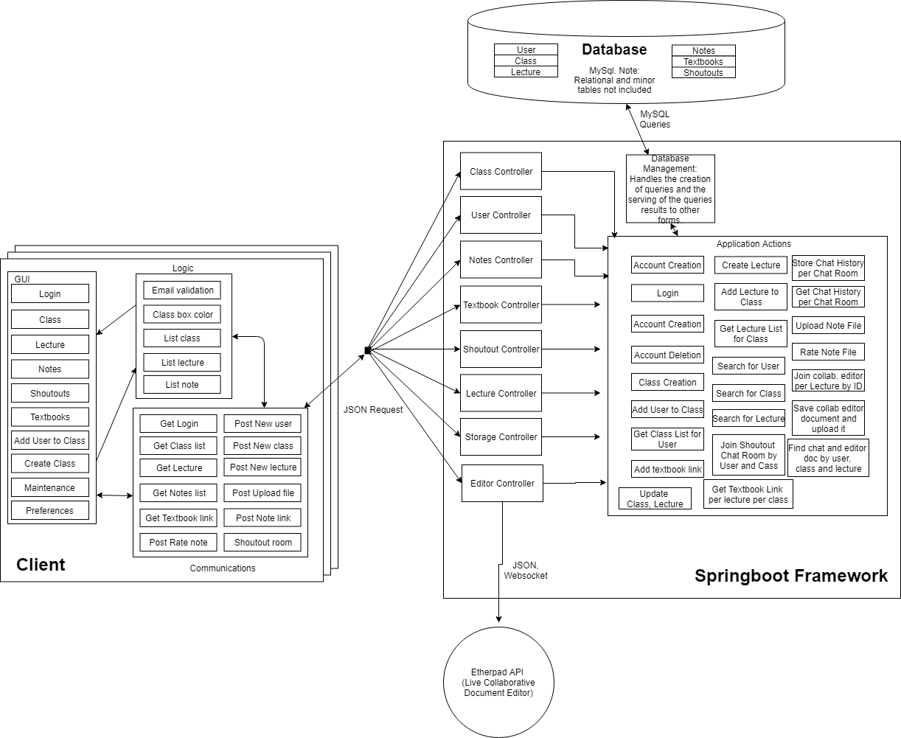
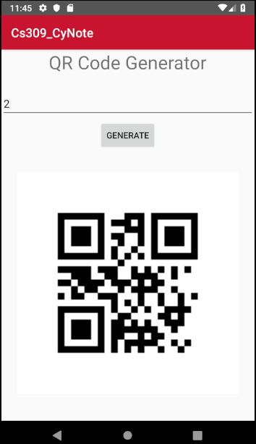
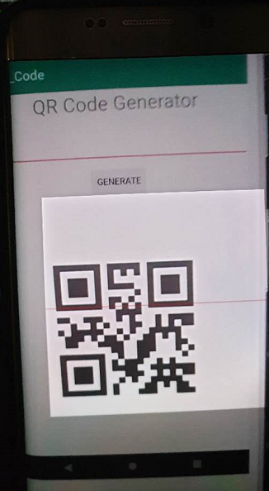
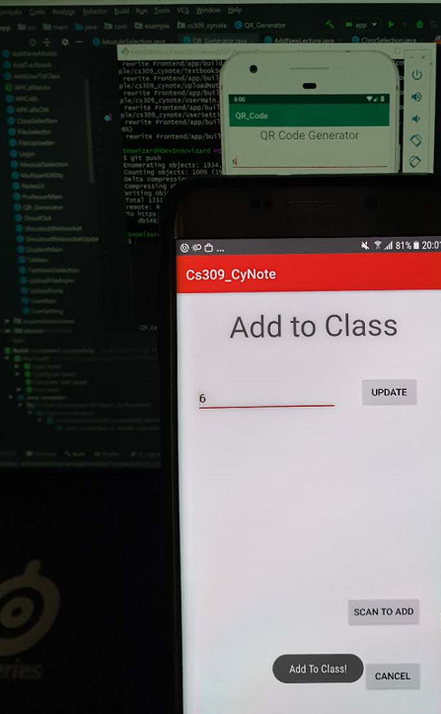
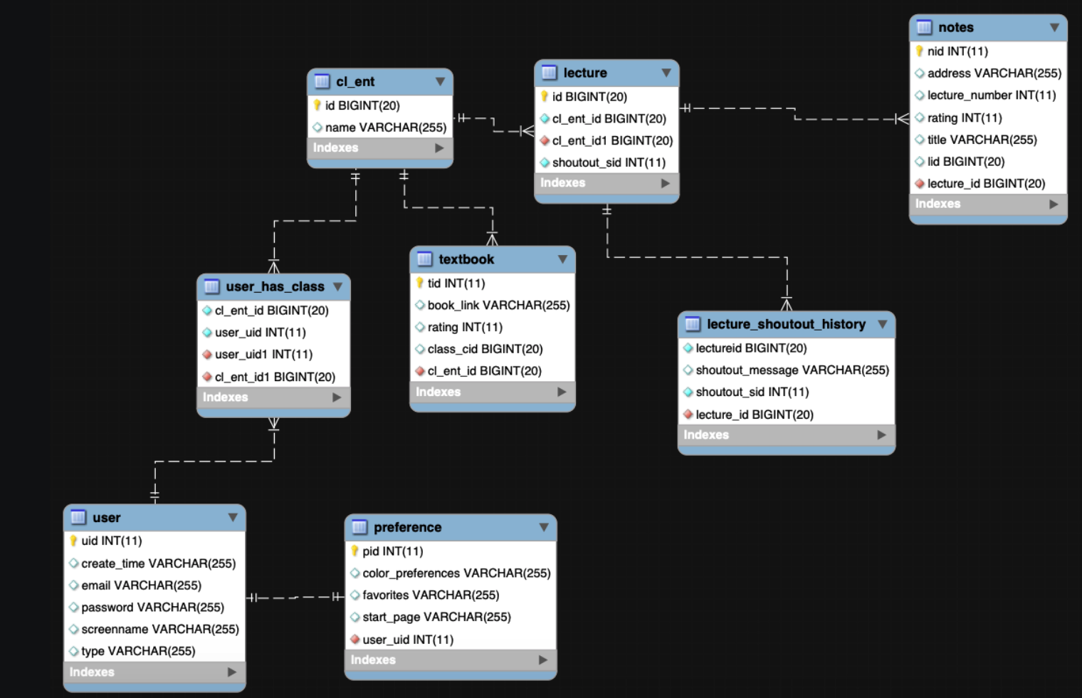
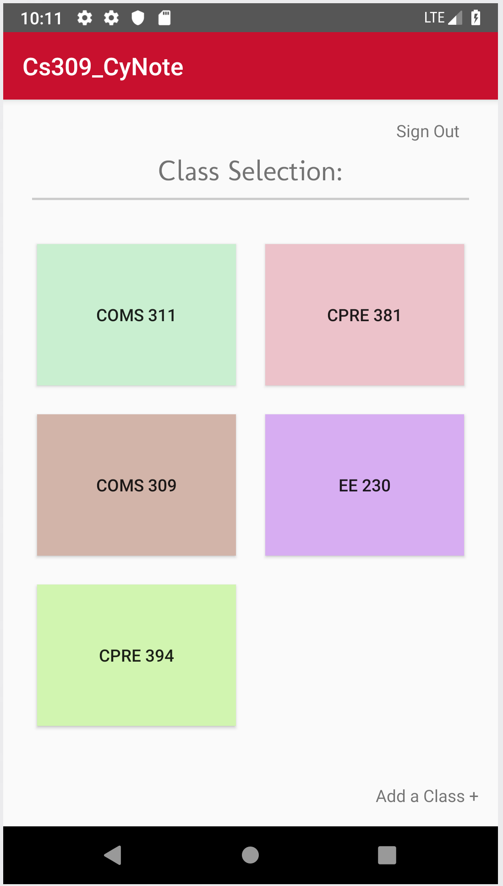
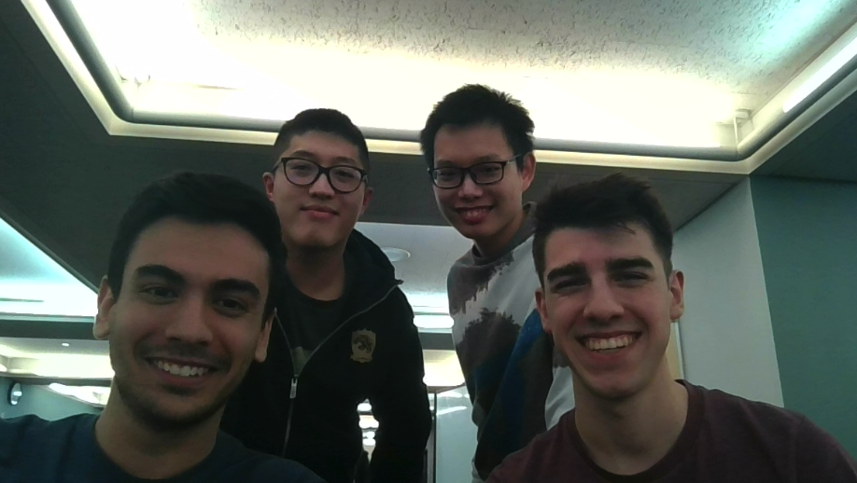
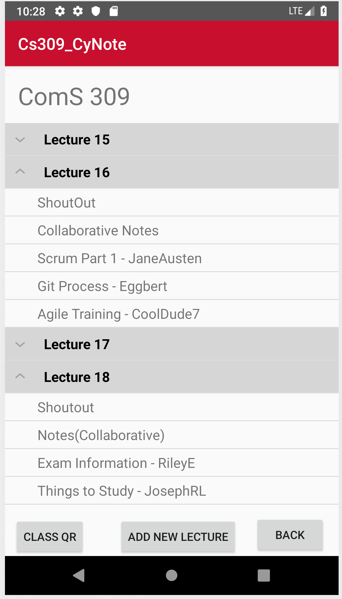
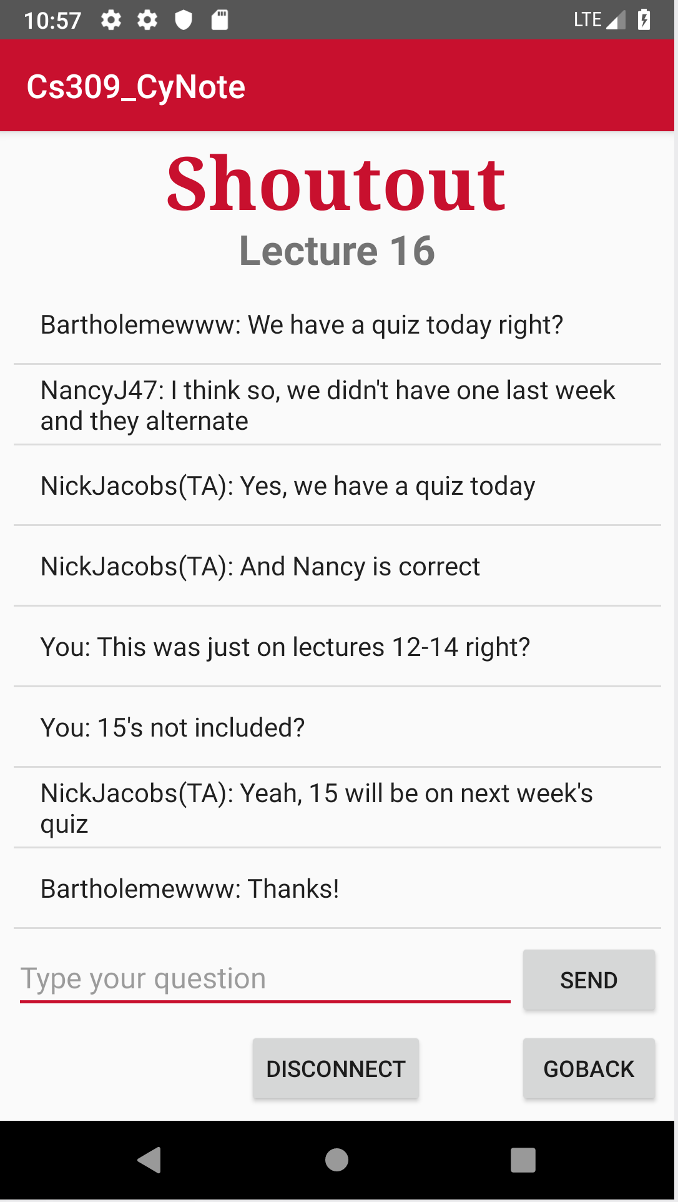
CyNote
COM S 309 SPR 2019
Project Description:
An educational tool similar to canvas. In addition to a class and lecture hierarchy for students, we provide a live, collaborative note taking environment. Students may also use our shoutout tool to anonymously ask the professor questions during lecture. Students can also share images of their handwritten notes. These notes can be voted on based upon quality at the discretion of a TA or professor. There is also a QR code creator/scanner for professors to give students a QR code so students may scan it and
automatically be added to the given class.
Users:
Students
Professors
TAs
Administrators
User Interfaces
Live Collaborative Note Taking
Shoutout Live Chat
Textbook Sharing
Notes Sharing and Voting
Class List
Lecture List
File Upload
Module Interfaces:
Back-End API Endpoints and Types (generalized) -
User -
Represents an account in the system, has access privileges ranging from Amin → Professor → TA → Student.
Each User is linked to a list of Class Entities that they are currently enrolled in.
Functional endpoints to create, deactivate, and modify a given User.
Class Entity -
Represents a school course in the system. Each Class Entity is linked to a list of Lectures.
Functional endpoints to create, deactivate, and modify a given Class Entity.
Lecture -
Represents one day’s lecture for a course in the system.
Each Lecture is linked to its own ShoutOut chat, Live Notes room, and a list of of Static Notes in order of rating.
Functional endpoints to create, deactivate, and modify a given Lecture.
ShoutOut -
Represents the live chat between Students, TAs, and Professors during one day of class.
ShoutOut rooms are only open for the duration of the physical lecture, plus a small amount of leeway, after which they will be closed to further messages by Students but still viewable in the app.
Functional endpoints to create, deactivate, and modify a given ShoutOut.
Live Notes -
Represents the live, collaborative note-taking efforts of any participating students for a specific lecture, viewable and editable at any time.
Functional endpoints to create, deactivate, and modify a given Live Notes room.
Static Note -
Represents a single User’s uploaded notes for a specific lecture, able to be upvoted and downloaded by anyone in the class.
Functional endpoints to create, deactivate, and modify a given Static Note.
Front-End API Calls (generalized)* -
volleyPost(...), volleyGet(...), and volleyGetArray(...)
Generic requests to a provided server endpoint, used in most locations to communicate with the server.
getUserNoClassList(...) with getClassList(...)
Returns a completed User, used to populate the Class Selection screen and is the starting point for a login.
getModuleList(...)
Updates a given Class with its respective list of lectures/modules, used to populate the Lecture Selection screen and provide updated information for processes.
getShoutOutHistory(...) alongside getNoteList(...)
Updates a given Lecture with its ShoutOut message history and its list of Static Notes respectively, used to populate dropdown menus in the Lecture Selection screen and provide updated information for processes.
*Note: Front-End uses most of the same object types as Back-End above, but their descriptions are excluded for brevity.
Design Decisions:
Database for instances of Live Notes
Database for ShoutOut chat history
Real-time refresh for Live Notes and ShoutOut
Class Selection and Module/Lecture Selection auto population
QR code scanner and generator for ease of access
Break API into simplified function calls passed generic callback interfaces
Offload calculations to server-side, keep client-side lightweight
Team Info:
Team SD_7
Marc Issac – ComS(Jr)
Sean Gordon – CPRE (Soph)
ZheMing Fan – ME (Jr)
Shen Chen – ME (Sr)
What went wrong:
Lack of communication between frontend and backend at the beginning of the semester
Had to change data structure
mid-project
What went right:
Completed project far
exceeding expectations
Great teamwork
Lessons Learned:
Test the project often
Construct data structure carefully

